Slide 1
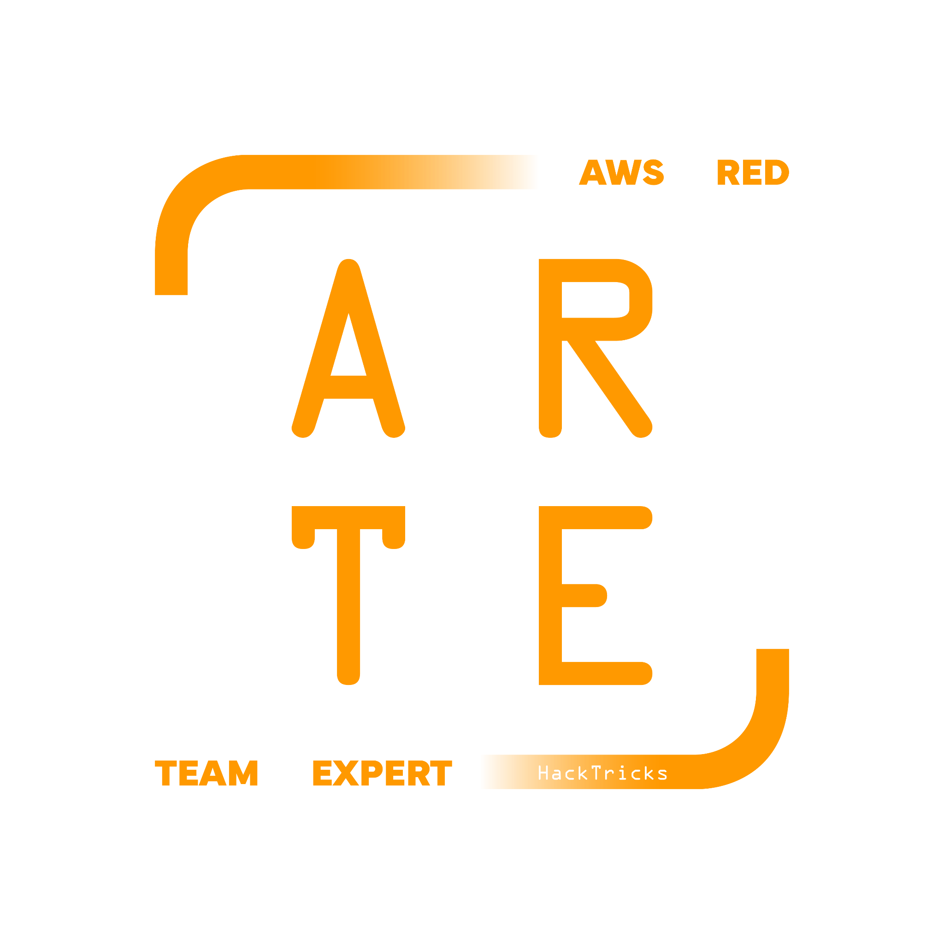
Other Security Services
HackTricks Training
https://t.me/CyberFreeCourses

Slide 2
CloudWatch
Amazon CloudWatch is a monitoring service for AWS cloud resources and the applications you run on AWS. It can be used to collect and track metrics, collect and monitor log files, set alarms, and automatically react to changes in your AWS resources.
https://t.me/CyberFreeCourses
https://cloud.hacktricks.xyz/pentesting-cloud/aws-security/aws-services/aws-security-and-detection-services/aws-cloudwatch-enum

Slide 3
Security Hub
AWS Security Hub provides a centralized and comprehensive view of your security state within AWS. It aggregates, organizes, and prioritizes security alerts and findings from multiple AWS services and third-party tools. SecurityHub also provides automated security checks based on industry standards and best practices.
https://t.me/CyberFreeCourses
https://cloud.hacktricks.xyz/pentesting-cloud/aws-security/aws-services/aws-security-and-detection-services/aws-security-hub-enum

Slide 4
Detective
Amazon Detective makes it easier to analyze, investigate, and quickly identify the root cause of potential security issues or suspicious activities. It automatically collects log data from your AWS resources and uses machine learning, statistical analysis, and graph theory to build interactive visualizations for faster incident investigation.
https://t.me/CyberFreeCourses
https://cloud.hacktricks.xyz/pentesting-cloud/aws-security/aws-services/aws-security-and-detection-services/aws-detective-enum

Slide 5
Inspector
Amazon Inspector is an automated security assessment service that helps improve the security and compliance of applications deployed on AWS. It automatically assesses applications for vulnerabilities and deviations from best practices.
https://t.me/CyberFreeCourses
https://cloud.hacktricks.xyz/pentesting-cloud/aws-security/aws-services/aws-security-and-detection-services/aws-inspector-enum

Slide 6
Config
AWS Config is a service that enables you to assess, audit, and evaluate the configurations of your AWS resources. It continuously monitors and records your AWS resource configurations and allows you to automate the evaluation of recorded configurations against desired configurations.
https://t.me/CyberFreeCourses
https://cloud.hacktricks.xyz/pentesting-cloud/aws-security/aws-services/aws-security-and-detection-services/aws-config-enum

Slide 7
WAF
AWS WAF (Web Application Firewall) helps protect your web applications or APIs against common web exploits that may affect availability, compromise security, or consume excessive resources. It allows you to customize rules to block specific traffic patterns, such as SQL injection attacks or attempts to exploit software vulnerabilities.
https://t.me/CyberFreeCourses
https://cloud.hacktricks.xyz/pentesting-cloud/aws-security/aws-services/aws-security-and-detection-services/aws-waf-enum

Slide 8
Shield
AWS Shield is a managed Distributed Denial of Service (DDoS) protection service that safeguards applications running on AWS. It provides always-on detection and automatic inline mitigations to minimize application downtime and latency.
https://t.me/CyberFreeCourses
https://cloud.hacktricks.xyz/pentesting-cloud/aws-security/aws-services/aws-security-and-detection-services/aws-shield-enum

Slide 9
Firewall Manager
AWS Firewall Manager is a security management service that allows you to centrally configure and manage AWS WAF rules, AWS Shield Advanced protections, and Amazon VPC security groups across all your accounts and applications.
https://t.me/CyberFreeCourses
https://cloud.hacktricks.xyz/pentesting-cloud/aws-security/aws-services/aws-security-and-detection-services/aws-firewall-manager-enum

Slide 10
And more…
https://cloud.hacktricks.xyz/pentesting-cloud/aws-security/aws-services/aws-security-and-detection-services
https://t.me/CyberFreeCourses

